Slide 1
LLE

Slide 2
Locally Linear Embedding
Find manifold by maintain local distances between points
Isomap we cared about all geometric distances between all points, here we just focus on local neighborhood

Slide 3
Locally Linear Embedding
Maintain global non-linear structure by just focusing on local linear distances (assuming distances on small scales can be approximated to be linear, even if manifold over large scales are non-linear)

Slide 4
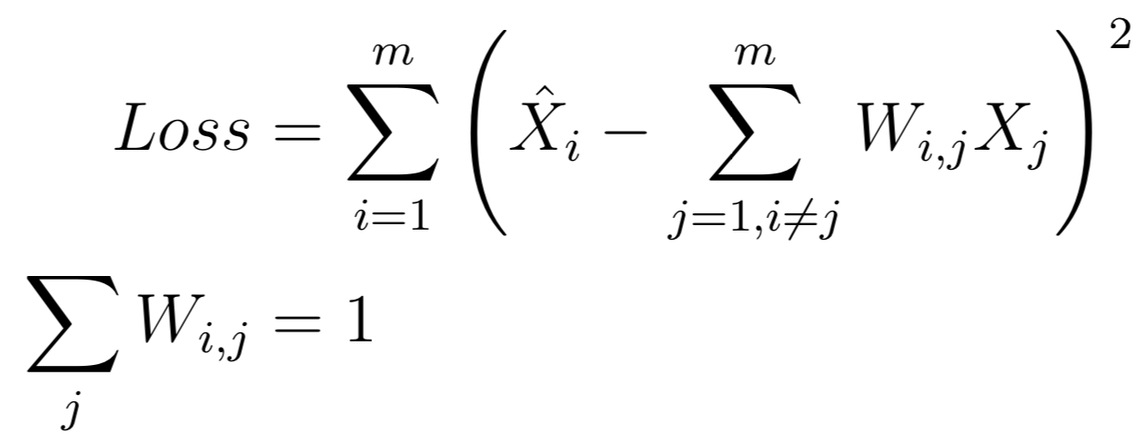
Implementation
Find nearest neighbors for our data points
Create a matrix that tracks local distances (linear) between data points in the neighborhood, this allows reconstruction of a datapoint purely from its neighbors
This gives us intrinsic geometric distances, which allows local reconstruction on original or embedded dimensions

Slide 5
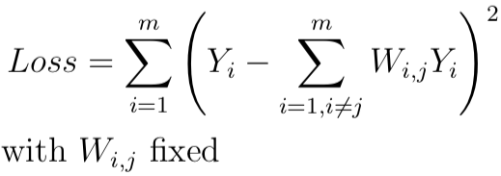
Implementation
Find nearest neighbors for our data points
Create a matrix that tracks local distances (linear) between data points in the neighborhood
Embed into lower dimensions by minimizing

Slide 6
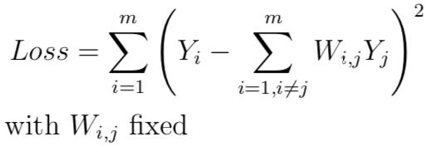
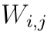
Implementation
m - number of observations
W - weight matrix for contribution of data point j to reconstruction of data point i
are 0 for data points not in local neighborhood of i

Slide 7
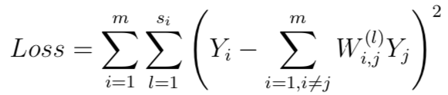
Modified LLE
When k neighbors >= n components we get more problems with singular matrices
One local weight vector -> multiple local weight vectors to deal with cases when solution has a 0 eigenvalue
Final Loss becomes...

Slide 8
Hessian LLE
Local weight vector found through Hessian matrix
Measures local curvature
Eig. Val. Decomposition of squared Hessian taking d smallest eig. Vals. for projection
Although computationally expensive, sklearn optimizations make it about as fast as other LLEs when output dimensions are small

Slide 9
Considerations
Enough data that our manifold is properly sampled in all neighborhoods and locally linear distance approximations hold (however computation time scales with number of data points too)
Distance weight matrices are invariant to scaling, translation, or rotation of the point and those in its local neighborhood, meaning we get intrinsic geometric distances

